Slide 1
Case Studies in
Community Wastewater Disposal Systems

Slide 2
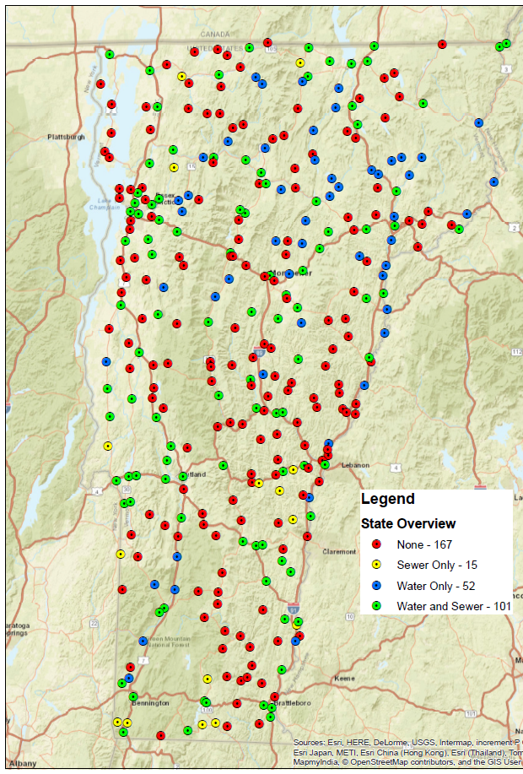
200+ Vermont villages Lack Sewage Treatment Facilities
Most are close to rivers, streams, or lakes
Limits opportunities for redevelopment
Hard to establish water-intensive businesses like food processing, restaurants and breweries.

Slide 3
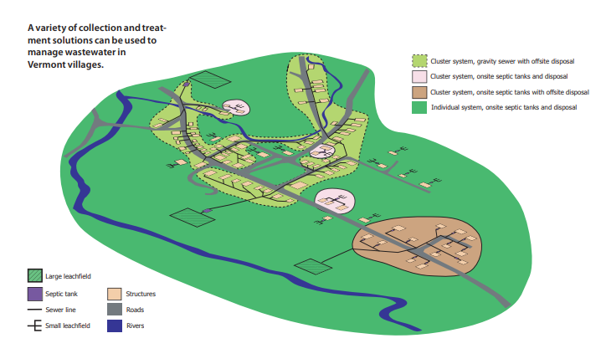
Sewage Solutions – Likely to be Decentralized
Multiple ▪ Small-Scale ▪ Incremental ▪ In-Ground Disposal

Slide 4
Affordability Metric
Annual User Rate
Median Household Income
= 1% to 2%

Slide 5
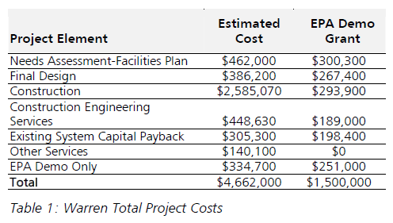
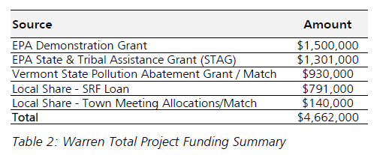
2003 Warren, Vermont
Community Decentralized Wastewater System
  10 individual system refurbishments
  1 cluster system with 3 properties
  78 properties to a large shared system
  Alternative treatment at school
2020 User Fees: $1180/year

Slide 6
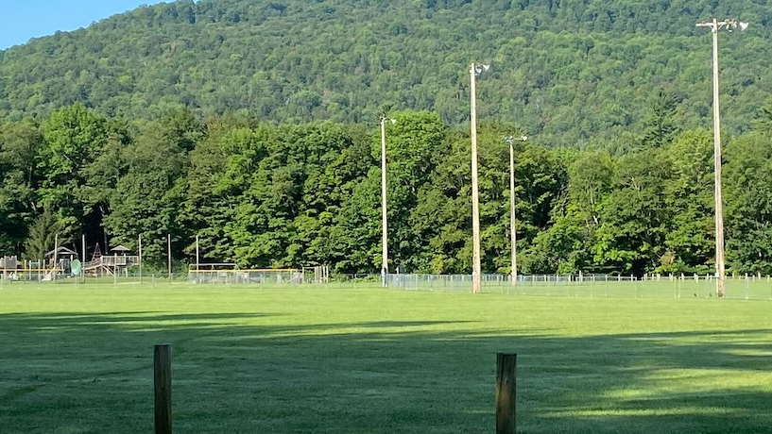

Slide 7
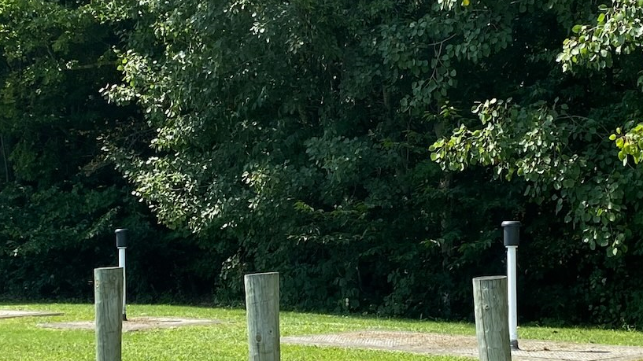

Slide 8
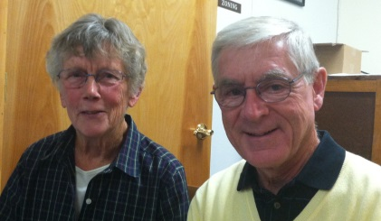
2016 Brownsville, Vermont
Ascutney Mountain Ski Area was going bankrupt
Purchased Ascutney mountain sewer system with CWSRF loan
Irene damaged village septic systems
Constructed village collection system & refurbished mountain sewer
Debt repayment split between grand list & user fees
User Fees: $865/year

Slide 9
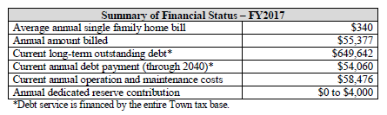
2018 Rochester, Vermont
Has 3 community soil based system sites & 1 reserve site
Originally built in1970’s for 66,150 gpd to end straight pipes
Rebuilding disposal field 2018
Maintaining a vital village area
User Fees: $340/year
Step | Costs | Funding Source
Planning | $11,068 | CWSRF
Design | $35,996 | CWSRF
Construction | $463,072 | CWSRF
Other | $11,000 | CWSRF
Total | $499,000 | $249,500

Slide 10
Grafton
Villages
Pump Out Program
Sewer feasibility study indicated a construction cost ranging from $3-4M
Town created a septic tank pump out ordinance for the village areas
User Cost: Approximately $285 every five years.
Owners must submit proof of pump out to the Town.
Town still concerned with ability to grow or redevelop village properties with small lots.

Slide 11
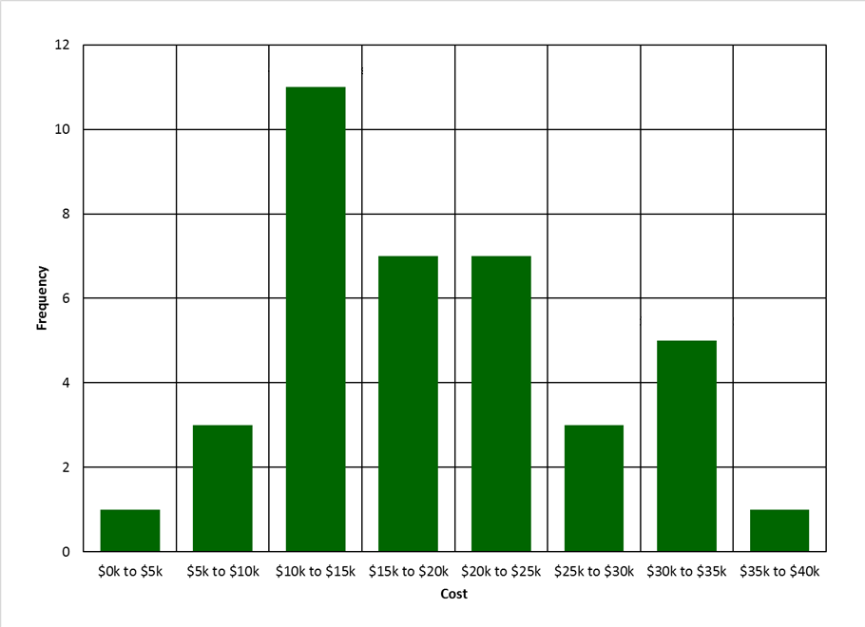
Individual On Site Case Studies
Annualized Replacement & O&M
Conventional: $677-971
Mound: $1,933
Innovative/Alternative: $3,000

Slide 12
Waitsfield Drinking Water System
New Drinking Water System
  Eliminated many isolation distance conflicts between private wells and septic systems
  $628/year ERU (2022)
New Community Wastewater System
  Bond Vote Failed
  Needed to repay almost $1M in planning & design loans
WW Community Loan Program
  Winterpark Industrial Park
  Mad Taco
  Local Smoke House
  Chinese Restaurant
  Municipal Offices

Slide 13
Benefits of Community Wastewater Systems
Management Systems for Pumping
Improvements in water quality
Lessened public health risks
May allow for infill development
May allow for economic development
Sustainable environmentally and economically

Slide 14
Privacy Concerns and Trust Building
Surveys and failure information typically collected by the consulting engineer and aggregated for reporting.
Policy on Working with Communities with Failed Septic Systems
Protect Public Health : Fencing & Lime addition

Slide 15
Keys to Successful Projects
Strong Wastewater Committee – Villages that moved forward with projects most often had engaged committees and public input
Visioning – Villages that moved forward with projects most often had completed complementary economic and planning studies
Capacity – Villages with installed systems had a part time or fulltime employee to run or manage the system (operation & admin)
Funding – Villages that moved forward with projects most often had grant funding in addition to loan funding
Affordability – Villages that moved forward found user rates that were affordable to rate payers

Slide 16
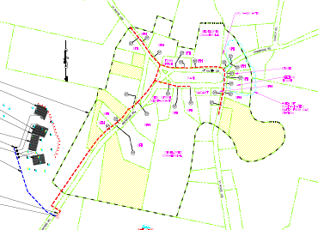
Westford
$3.3M Total Project Cost
$15K Engineering Planning Advance
~$18K Municipal Planning Grant
$300K land purchase
Remainder CWSRF Loan, Westford is not USDA-RD Eligible, MHI = $91K
 | 100% Loan | 65% Loan | 50% Loan
Equivalent User Rate Affordability | $1,638/ year 1.7% | $1,180/year 1.3% | $754/year 0.8%

Slide 17
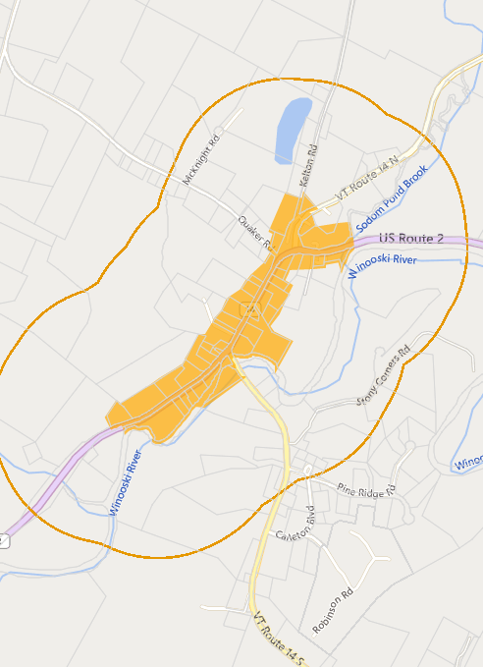
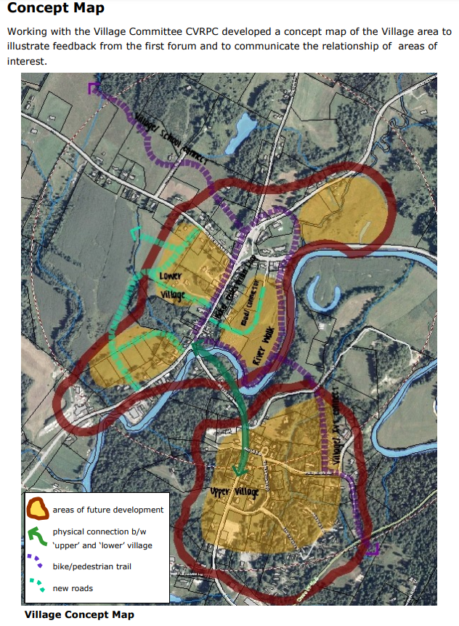
Eligible Areas vs Local Planning

Slide 18
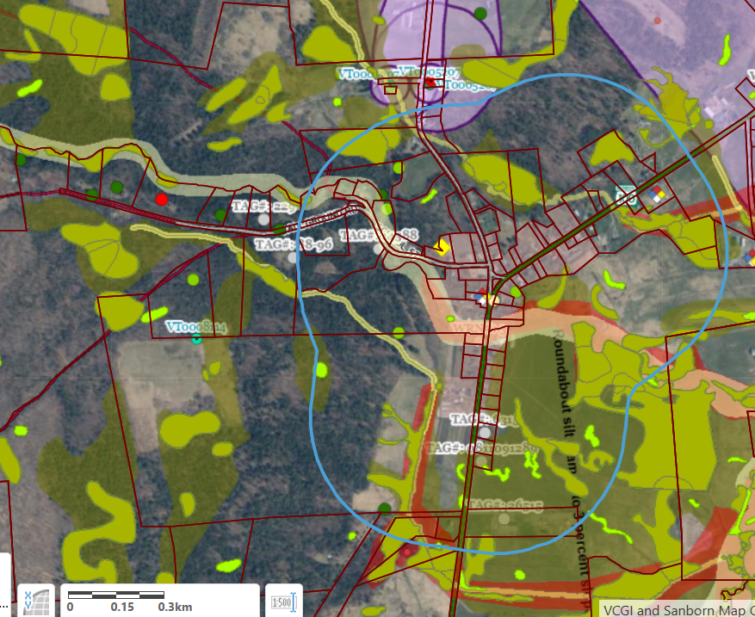
Constraining Features
Village Center Buffer
Flood Hazard Areas
Wetlands
High Ledge
Endangered Species

Slide 19
Questions?
Lynnette Claudon, PE
Lynnette.Claudon@Vermont.gov
802-490-6226
Village Wastewater Solutions Initiative
https://dec.vermont.gov/village-wastewater

